Slide 1

Rockbuster Stealth data analysis project
Allie Qualman
May 31st, 2022

Slide 2
Key Questions and Objectives
Which movies contributed the most/least revenue gain?
What was the average rental duration for all videos?
Which countries are Rockbuster customers based in?
Where are customers with a high lifetime value based?
Do sales figures vary between geographic regions?

Slide 3
Which movies contributed the most/least revenue gain?
Most Revenue
Least Revenue
Rank | Movie | Revenue
1 | Telegraph Voyage | 215.75
2 | Zorro Ark | 199.72
3 | Wife Turn | 198.73
4 | Innocent Usual | 191.74
5 | Hustler Party | 190.78
6 | Saturday Lambs | 190.74
7 | Titans Jerk | 186.73
8 | Harry Idaho | 177.73
9 | Torque Bound | 169.76
10 | Dogma Family | 168.72
Rank | Movie | Revenue
1 | Duffel Apocalypse | 5.94
2 | Oklahoma Jumanji | 5.94
3 | Texas Watch | 5.94
4 | Freedom Cleopatra | 5.95
5 | Rebel Airport | 6.93
6 | Young Language | 6.93
7 | Cruelty Unforgiven | 6.94
8 | Treatment Jekyll | 6.94
9 | Lights Deer | 7.93
10 | Japanese Run | 7.94

Slide 4
What was the average rental duration for all videos?
 | Range | Average
Rental Duration (Days) | 3-7 Days | 5 Days
Rental Rate ($) | .99 - 4.99 | 2.98
Movie Length (Minutes) | 46 - 185 | 115
Replacement Cost ($) | 9.99 – 29.99 | 19.99

Slide 5
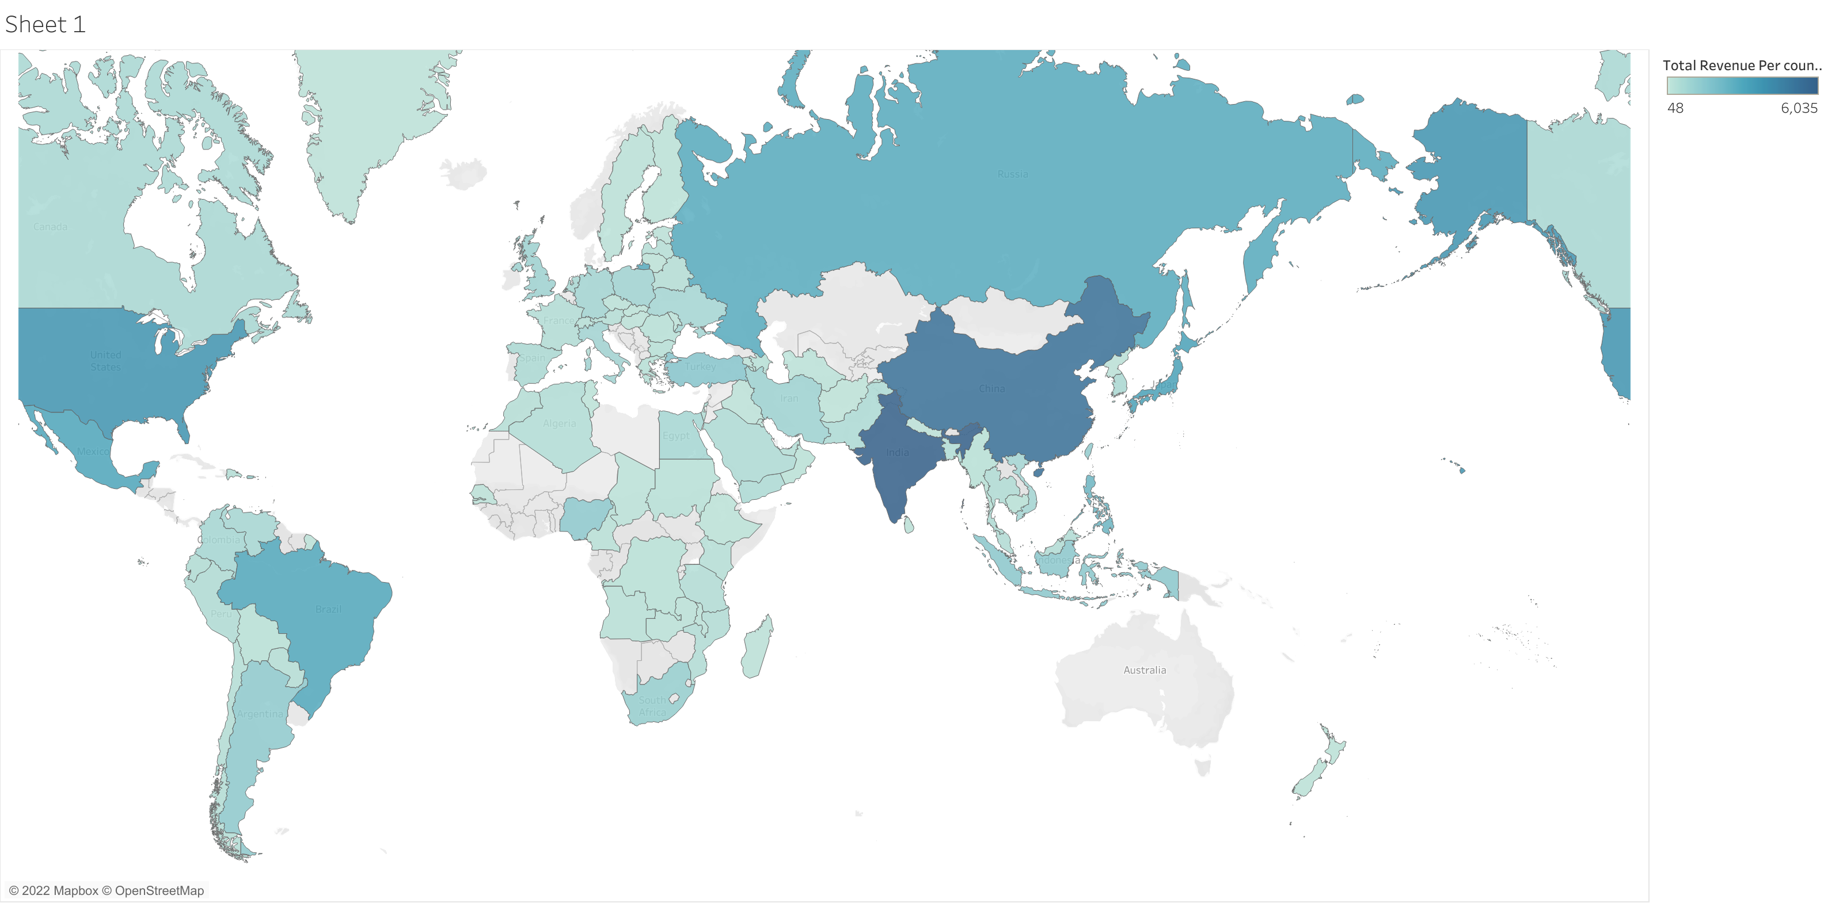
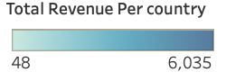
Which countries are Rockbuster customers based in and who brought in the most revenue?
Revenue From Top 5 Countries
Rank | Country | Revenue
1 | India | 6034.78
2 | China | 5251.03
3 | United States | 3685.31
4 | Japan | 3122.51
5 | Mexico | 2984.82
All countries colored are customers of Rockbuster. The darker the blue, the more revenue the country brought in.

Slide 6
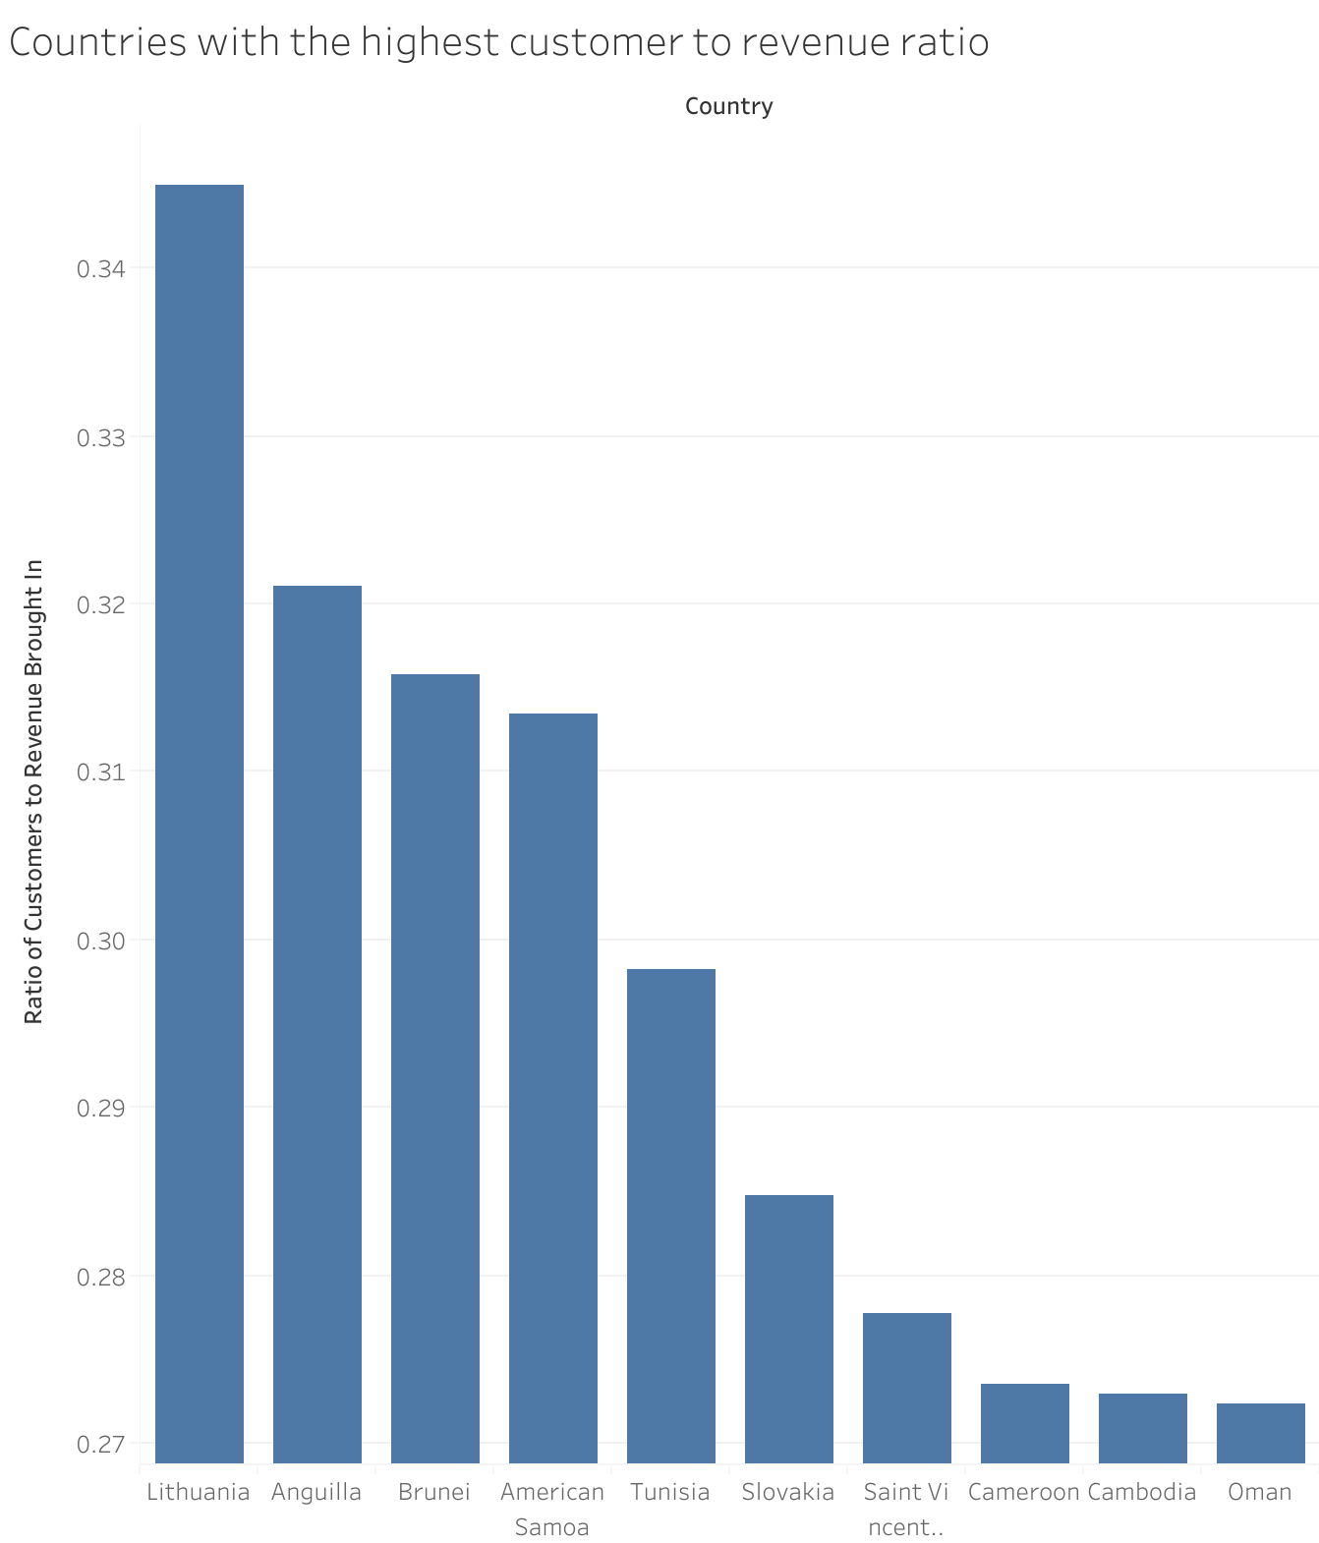
These top ten countries have the loyalist customers. With the least amount of customers bringing in the most amount of revenue:
1. Lithuania
2. Anguilla
3. Brunei
4. American Samoa
5. Tunisia
6. Slovakia
7. Saint Vincent
8. Cameroon
9. Cambodia
10. Oman

Slide 7
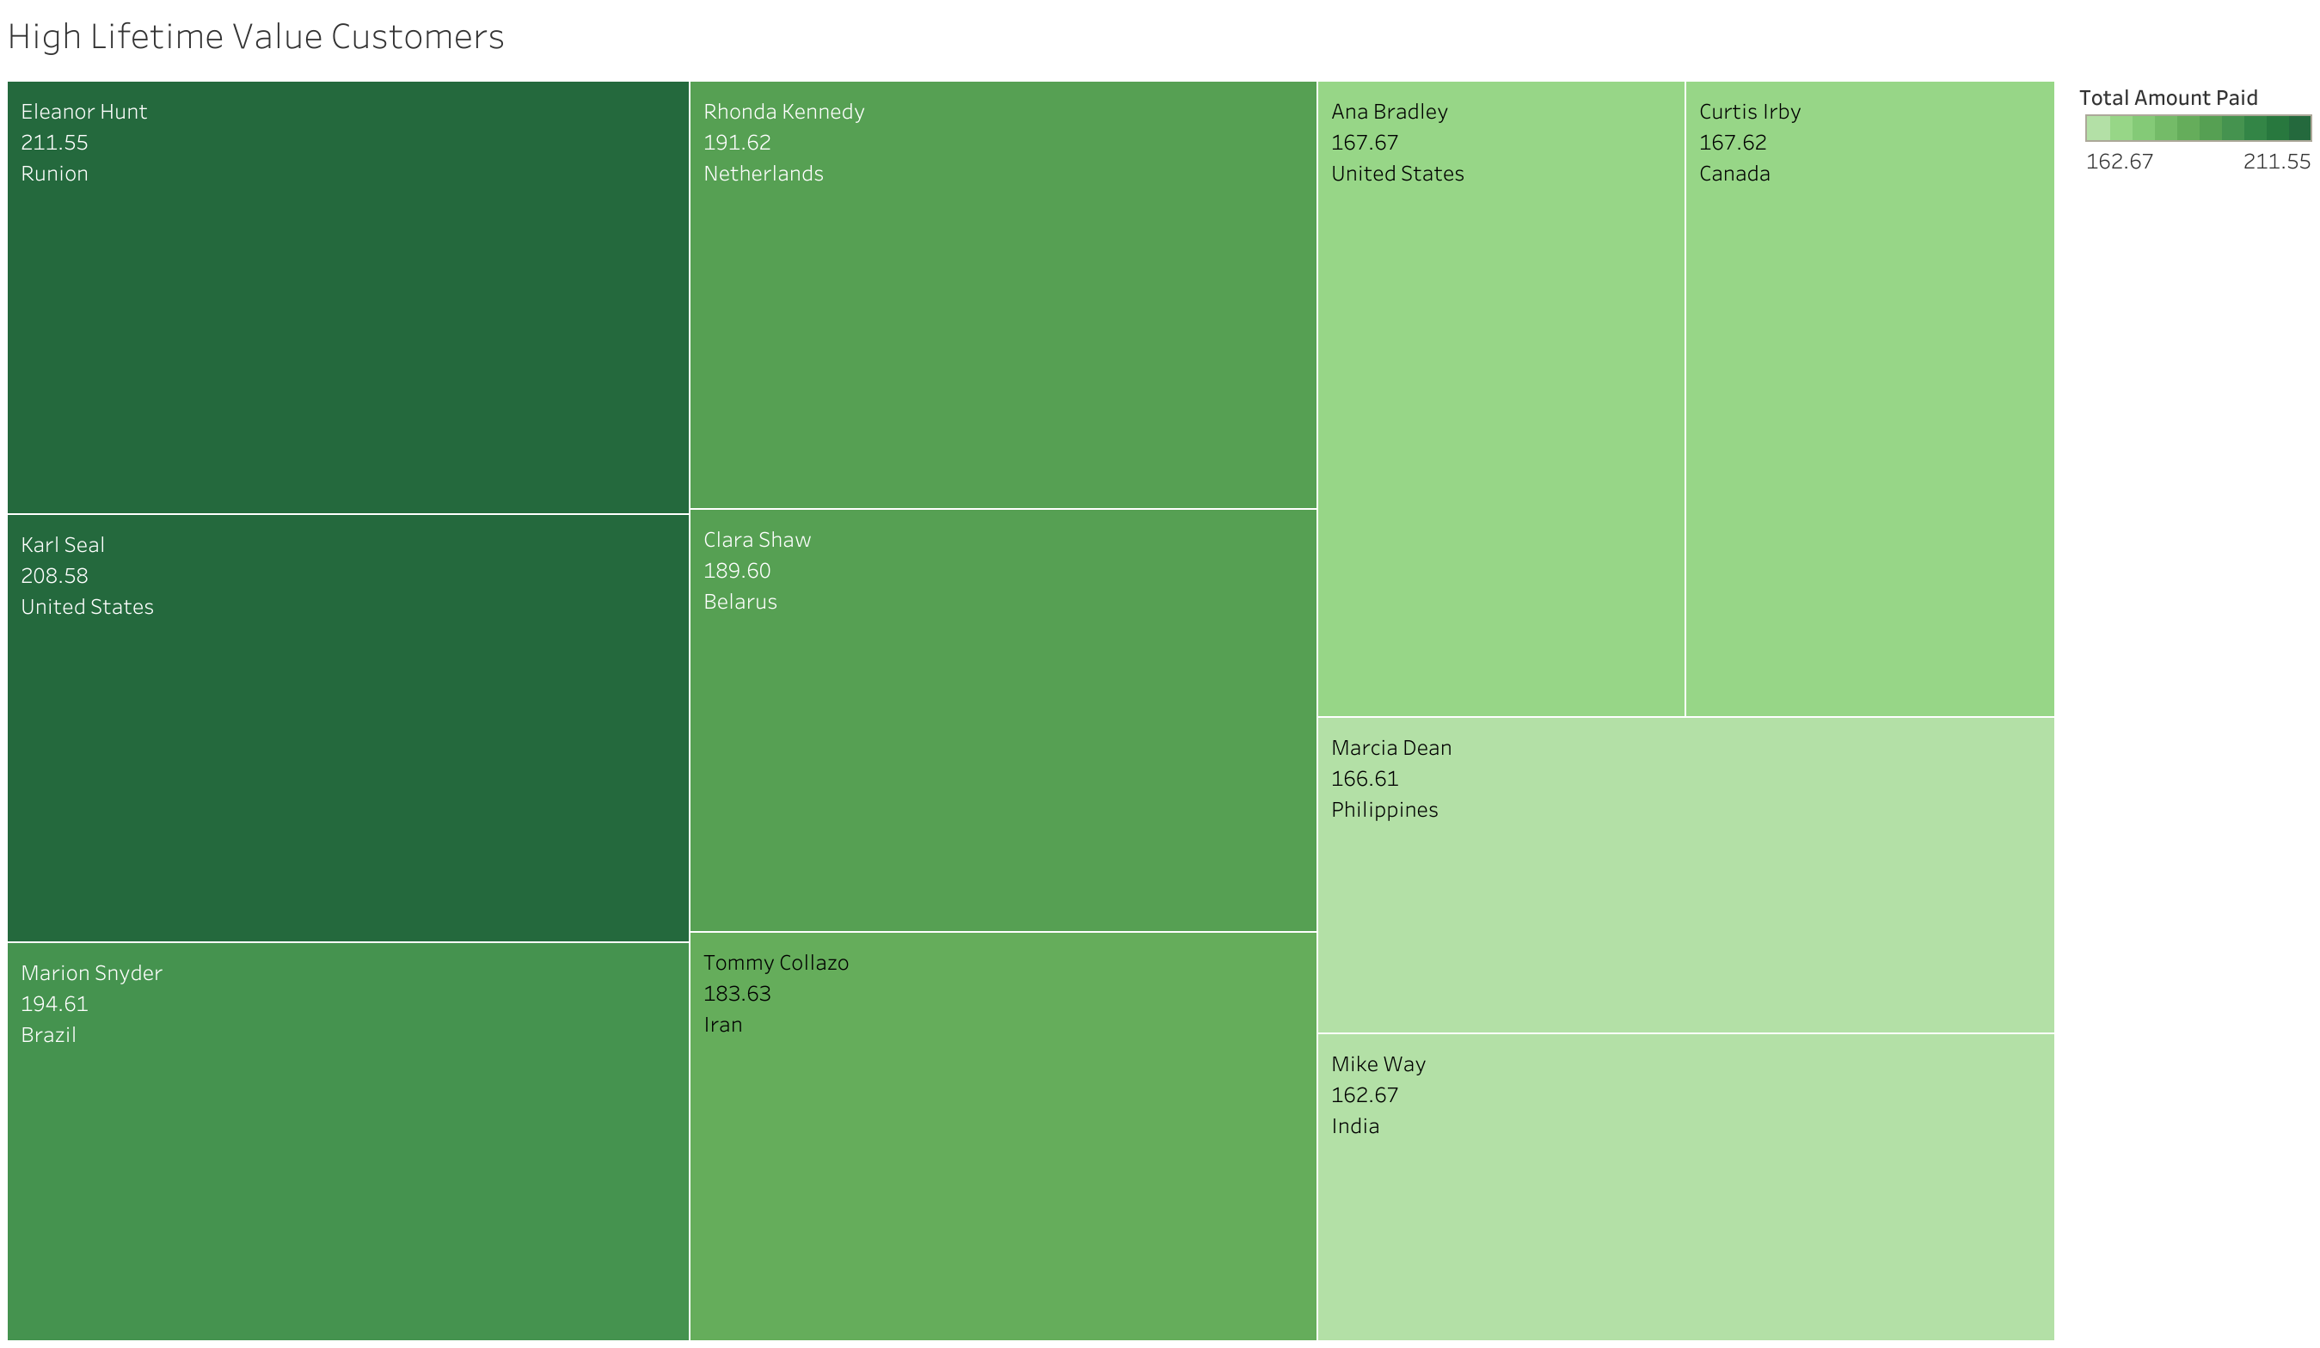
Where are customers with a high lifetime value based?

